Slide 1
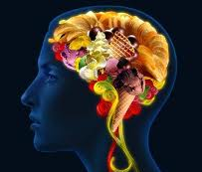
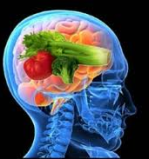
Nutrition’s Role in Brain Health
Pam VanKampen, RDN, CD
Pam.vankampen@gwaar.org

Slide 2
Dedicated to My Mom…My Hero!

Slide 3
You are What you Eat
Every atom, every molecule, every cell, tissue, organ and system in your body is made up of the ingredients in the foods you eat, the water your drink and the air you breathe.
Proper and adequate nutrition:
Sustains life
Provides energy
Helps with tissue growth and repair

Slide 4
Impact of Brain Chemistry on Health
We are altering our brain chemistry constantly through:
What we eat
How we exercise
How we sleep
How we think
All our behaviors create neurochemical changes in the body.

Slide 5
Did you Know…
There are 40+ nutrients and more than 12,000 phytonutrients in foods that your body and brain can’t make by itself but require to function in tip-top shape.
The amount of balance of those thousands of nutrients determines whether you are happy or sad, smart or forgetful, energetic or lethargic, healthy or diseased, living vibrantly or dragging through the day.

Slide 6
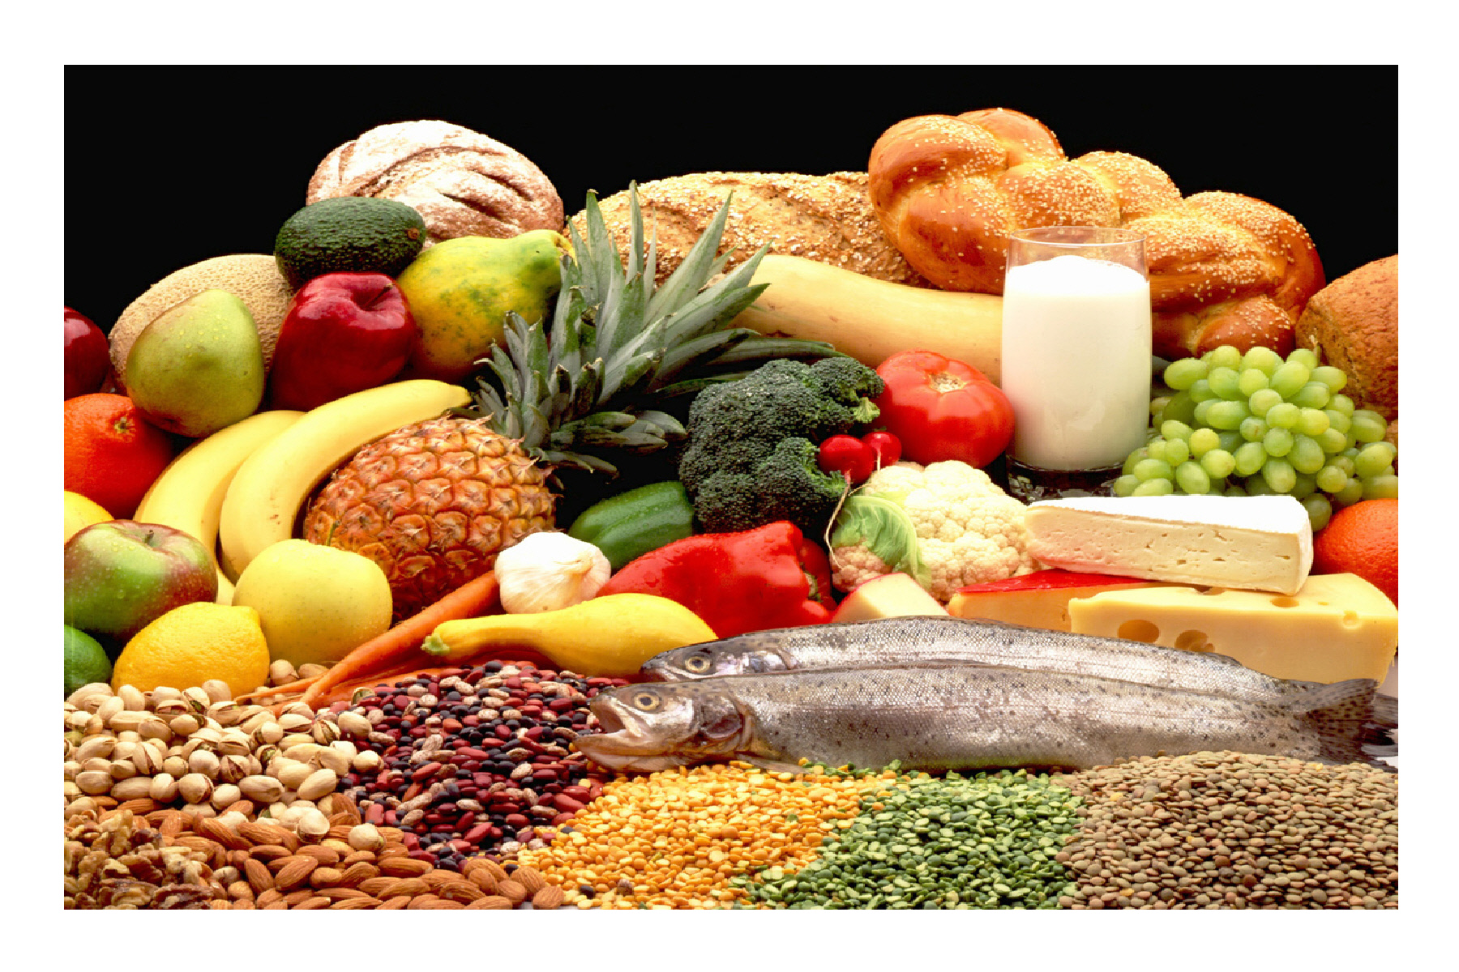
Nutritious and Balanced Diet
A diet rich in natural vitamins and antioxidants
Low in saturated fats
Rich in omega-3 fats
Low in refined sugar
Rich in high-quality proteins

Slide 7
It’s an Inflammation Situation!

Slide 8
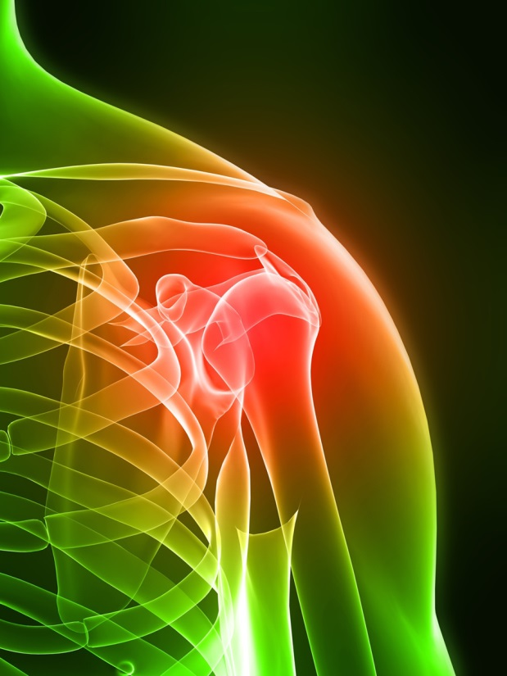
SAD DIET (Standard American Diet)
The worst things that trigger cortisol release and cause inflammation, like flipping a light switch, are:
Sugar (added sugar)
Trans Fats
White Flour

Slide 9
Your Brain on Sugar
Sugar fuels every cell in the brain.
Your brain sees sugar as a reward, which makes you keep wanting more of it.
By eating a lot of sugar, you're reinforcing that reward, which can make it tough to break the habit.

Slide 10
Kick the Habit in Baby Steps
Start by eating more fruits and vegetables.
Drink extra water.
Check food labels, and pick those that don't have a lot of sugar. (less than 5 grams per serving)
Cut out a little bit of sugar each week.

Slide 11
Snacks are a bridge
Don't skip this important eating event.
Snacks should have protein and fiber-rich carbohydrates to provide lasting energy.
Grab an apple and a handful of nuts, carrots and string cheese, or Greek yogurt and fresh berries, hummus and veggies.
Keep in mind that snacks are not intended to fill you up, but to bridge you from one meal to the next.

Slide 12
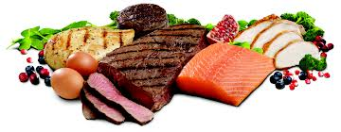
Let Protein Help
Eating protein is an easy way to curb sugar cravings.
High-protein foods digest more slowly, keeping you feeling full for longer.
Protein doesn't make your blood sugar spike the way refined carbs and sugars do.
Pick proteins like lean chicken, low-fat yogurt, eggs, nuts, or beans.

Slide 13
Water
Your body needs an ongoing water supply throughout the day.
Many Fruits and Veggies are high in water!

Slide 14
Dehydration causes your brain to shut down and not run at full speed.
Symptoms of dehydration include: brain fog, afternoon fatigue, focus issues, depression, anger, emotional instability, exhaustion, headaches, sleep issues, stress, and a lack of mental clarity and acuity
Over 70 percent of your body is composed of water and every function in the body is dependent on water, including the activities of the brain and nervous system.
Yet according to the Mayo Clinic, the average adult loses more than 80 ounces of water every day through sweating, breathing, and eliminating wastes.

Slide 15
The brain is approximately 85 percent water and brain function depends on having abundant access to water.
Water gives the brain the electrical energy for all brain functions, including thought and memory processes.
Water is needed for the brain's production of hormones and neurotransmitters.
Your brain does not have any way to store water.
Source: http://www.waterbenefitshealth.com/water-and-brain.html

Slide 16
Studies have shown that if you are only 1 percent dehydrated, you will likely have a 5 percent decrease in cognitive function.
If your brain drops 2 percent in body water, you may suffer from fuzzy short-term memory, experience problems with focusing, and have trouble with math computations.
Further studies have shown that prolonged dehydration causes brain cells to shrink in size and mass. This is most common in the elderly, many of whom tend to be chronically dehydrated for years.

Slide 17
Fighting Dementia with Food!
The MIND Diet

Slide 18
MIND Diet (Mediterranean-DASH Intervention for Neurodegenerative Delay)
Brain Healthy Foods
Limit These
Green leafy veggies- every day
Other veggies- at least once a day
Nuts- every day
Berries- at least twice a week
Beans- every other day
Whole grains- 3 times per day
Fish- at least twice a week
Poultry- at least twice a week
Olive oil
Wine- 1 glass per day
Red Meats
Butter and Stick Margarine- less than 1 TBSP per day
Cheese - less than 1 serving per week of whole fat cheese
Pastries and Sweets- limit to 1 serving a week
Fried or fast food: less than one serving per week.

Slide 19
Promising Findings
Study at Rush University found this diet can significantly reduce the risk of developing Alzheimer’s disease, even with moderate compliance!
53% lower risk for strict adherence
35% lower risk for moderate adherance
Combines Mediterranean and DASH diet and added other foods that have been found to improve cognitive function and delay decline.
Dietary Vitamin E is potent antioxidant associated strongly with brain health
Nuts, plant oils, seeds and leafy greens
Omega-3s, especially DHA, are important lipid structures in the brain
Higher synaptic transmission
Less oxidative stress
B Vitamins, such as folate, Vit. C and D, all help neurons cope with aging.
Vegetables are important to prevent cognitive decline, but green leafy are very protective.
Spinach, Kale, Collard Greens, Romaine- at least 6 times a week
Berries help reduce neuron loss and improve memory performance

Slide 20
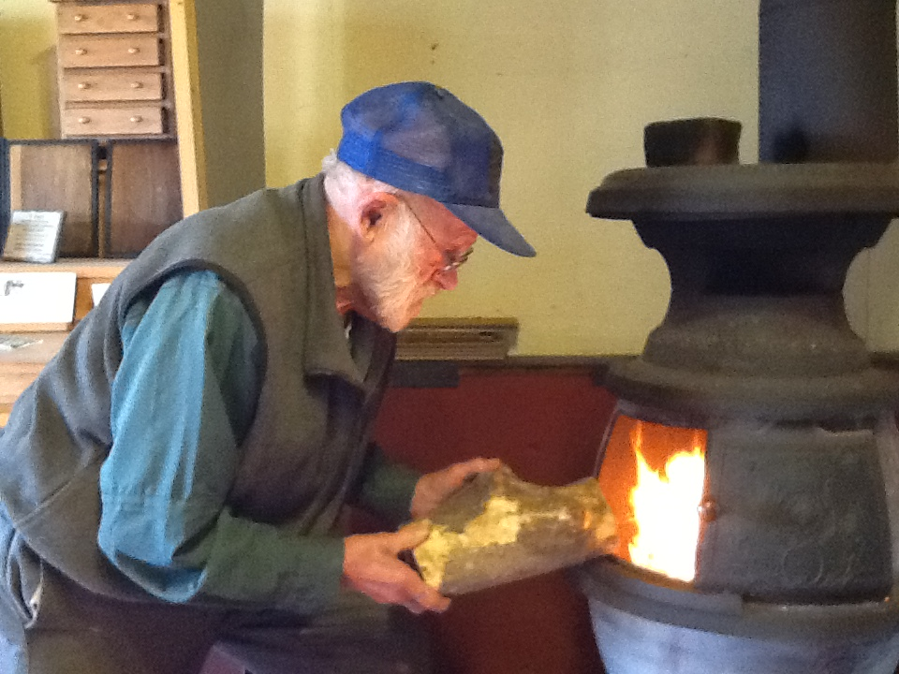
Feeding the Fire!
Alcohol in excess over many years
Excess Sodium linked to hypertension is a risk for dementia
A diet high in saturated and trans fats
Excess calories leading to obesity
Elevated blood glucose
“Senior Moments” could be due to elevated or poorly controlled blood glucose.
Skipping Meals.
The goal is to keep blood glucose steady. Erratic eating may trigger anxiety, panic, anger and depressed feelings.
Refined carbs can send blood glucose crashing down and that can trigger anxiety, panic attacks and stress.

Slide 21
Easy Peasy…US News & World Report ranked the MIND diet as easiest to follow in 2016.
Have a green salad and one other veggie daily
Fill half your plate with veggies. http://www.choosemyplate.gov/
Frozen berries are as nutritious as fresh, eat & buy seasonally.
Snack
Add to salad, oatmeal, smoothie, yogurt
Handful of nuts for a snack
Chicken and fish 2-3 times a week
3 Whole grain servings
Oatmeal and sandwich for lunch
Toast and barley soup
Brown rice and popcorn
Beans
Rinsed canned beans can be added to salads, soups, served over rice, mixed with eggs,

Slide 22
Healthy Summer Menu Ideas http://www.fruitsandveggiesmorematters.org/healthy-menu-ideas-summer

Slide 23
Roasted Veggies are healthy and Tasty!
Virtually all veggies can be roasted
Simply place your veggies on a cookie sheet and mist them lightly with canola or olive pan sprays, or toss them in a little olive oil.
Season them to your preference- try a little kosher sea salt, pepper and garlic
Roast at 375 degrees for 15 to 25 minutes or until they have a golden covering and texture that suits you.
Sprinkle with a little balsamic vinegar and enjoy!
Cauliflower, sweet potatoes, Brussels sprouts, carrots and asparagus are all excellent!

Slide 24
Veggie and Fruit Resources
http://www.fruitsandveggiesmorematters.org/fruit-veggie-nutrition
http://www.fruitsandveggiesmorematters.org/fresh-frozen-canned-dried-and-100-juice
http://www.fruitsandveggiesmorematters.org/top-10-healthy-ways-to-cook-fruits-and-vegetables
http://www.fruitsandveggiesmorematters.org/cooking-tips

Slide 25
Beautiful BEANS!
The brain is dependent on glucose for fuel. Since it can’t store glucose, it relies on a steady stream of energy which beans help provide.
High in fiber, protein, antioxidants and low glycemic index carbohydrates
B vitamins, essential amino acids

Slide 26
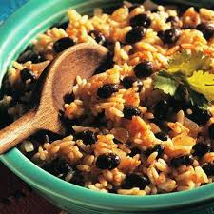
Add Beans!
Add to almost anything:
Tacos
Spaghetti
Salads
Hot Dish
Soups
Baked Goods
Scrambled Eggs
Resources:
Bean Institute.com http://beaninstitute.com/
Bush Beans.com http://www.bushbeans.com/
Black Bean Brownies http://www.yummly.com/recipes?q=black+bean+brownies

Slide 28
Whole Grains
Read the ingredients list and choose products that name a wholegrain ingredient first on the list.
Look for “whole wheat,” “brown rice,” “bulgur,” “buckwheat,” “oatmeal,” “whole-grain cornmeal,” “whole oats,” “whole rye,” or “wild rice.”
Be a smart shopper. The color of a food is not an indication that it is a whole-grain food. Foods labeled as “multi-grain,” “stone-ground,” “100% wheat,” “cracked wheat,” “seven-grain,” or “bran” are usually not 100% whole-grain products, and may not contain any whole grain.

Slide 30
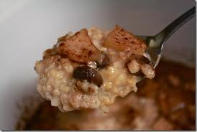
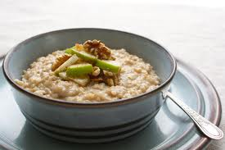
CROCK POT STEEL CUT OATS
1 Cup Steel Cut Oats
4 cups water
1/2 cup milk
1 fresh apple, chopped
1/4 cup brown sugar
1 Tbsp butter
1/2 tsp vanilla
1 t cinnamon
Put all into crock pot. Cover.
Cook on low for 8 hours.
Makes 1.5 quarts

Slide 31
Blueberries
Help protect from short term memory loss because of the large amounts of protective antioxidants in the skin.
Protects against oxidation and inflammation.
Toss some in a salad, muffin or breads, on pancakes, on cereal, eat as a snack, try them frozen…but be sure they don’t have added sugar!

Slide 32
The Right Fats
In a study of 3600 people over 65, one group at Omega 3 rich fish 3 times a week and the other group did not eat fish regularly.
The fish eaters had a 25% reduction in the risk of silent infarcts of the brain that are associated with dementia.
Improve neurologic and mental health
Decrease inflammation in the body, which helps with mood and depression.

Slide 33
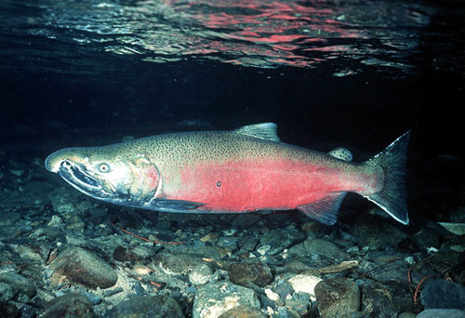
Your Brain on DHA (docosahexaenoic acid_
Omega-3 fatty acid that contain anti-inflammatory substances. Low levels may increase risk of Alzheimer’s
Present at the nerve endings in your brain. Helps memory and brain performance.
Halibut, mackerel, wild salmon, farm trout, herring and tuna- baked, broiled or grilled.
4 to 6 ounce serving 2-3 times a week.

Slide 34
Tuna & Mercury
Note: Chunk light tuna, like all fish and shellfish, contains some mercury.
According to the FDA and EPA, women who are or might become pregnant, nursing mothers and young children should limit their consumption to 12 ounces a week of fish with lower mercury, including canned “light” tuna.
Consumption of albacore tuna (which is labeled “white”) should be limited to no more than 6 ounces a week.

Slide 35
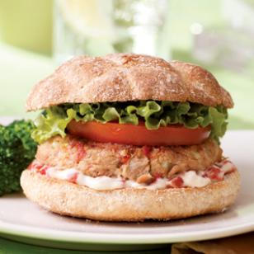
Tuna Burger
INGREDIENTS
2 5- to 6-ounce cans chunk light tuna - drained
1/2 cup coarse dry whole-wheat breadcrumbs
1/2 cup low-fat mayonnaise, divided
1 4-ounce jar chopped pimientos, drained, or 1/3 cup chopped roasted red peppers, divided
1/4 cup finely chopped celery
1/4 cup finely chopped onion
1/2 teaspoon Old Bay seasoning, divided
1 tablespoon extra-virgin olive oil
4 whole-wheat hamburger buns or English muffins, toasted
4 lettuce leaves
4 slices tomato
http://www.eatingwell.com/recipes/quick_tuna_burger.html
PREPARATION
Combine tuna, breadcrumbs, 1/4 cup mayonnaise, half of the pimientos (or roasted red peppers), celery, onion and 1/4 teaspoon Old Bay seasoning in a medium bowl, breaking up any larger pieces of tuna until the mixture is uniform and holds together.
Combine the remaining 1/4 cup mayonnaise, the remaining pimientos (or peppers) and 1/4 teaspoon Old Bay seasoning in a bowl.
Heat oil in a large nonstick skillet over medium heat. Using a generous 1/3 cup each, form the tuna mixture into four 3-inch burgers. Cook until heated through and golden brown, about 2 minutes per side.
Spread the top half of each bun (or English muffin) with pimiento mayonnaise and place a burger, lettuce and tomato on the bottom half.
Per serving: 321 calories; 12 g fat (2 g sat, 5 g mono); 20 mg cholesterol; 39 g carbohydrates; 5 g added sugars; 17 g protein; 5 g fiber; 647 mg sodium; 365 mg potassium.

Slide 36
Quick & Healthy Meal Idea
3 oz. single serve pouch of shelf stable wild Alaskan salad.
1000 mg of omega-3 fats, 13 grams of protein and over 100% of the RDA for Vitamin D and all for only 120 calories!

Slide 37
Choose Healthy Omega 3Fats
Improve your mood and can help you to lose weight
ALA (flaxseeds, walnuts, canola oil, leafy greens or soy) help lower heart disease risk
EPA and DHA help improve mood (Fatty fish- salmon, herring, lake trout, anchovies and sardines) or Fish Oil or foods fortified with DHA
Goal: 200 mg of DHA per day

Slide 38
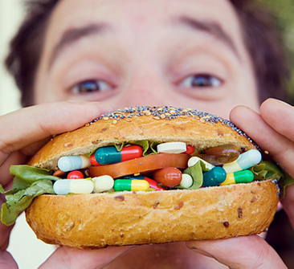

Slide 39
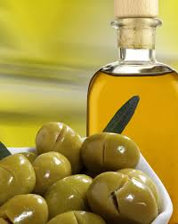
Extra Virgin Olive Oil
Extra Virgin Olive Oil:
Highest amount of monounsaturated fats. Have polyphenols- potent antioxidants and anti-inflammatory compounds & high amount of oleic acid that triggers the release of potent appetite-suppressing neurochemicals, which quiet the brain’s hunger center and can delay stomach emptying and makes you feel fuller longer!

Slide 40
Nuts and Seeds
Good source of vitamin E that seems to correspond with less cognitive decline as you age.
Add an ounce a day to your diet.
Walnuts, hazelnuts, Brazil nuts, filberts, almonds, cashews, peanuts, sunflower seeds, sesame seeds, flax seed, UNHYDROGENATED nut butters
Nut Nutrition Data Base http://www.fruitsandveggiesmorematters.org/nut-nutrition-database

Slide 42
Pumpkin seeds
High in magnesium and tryptophan, an amino acide that is a precursor to serotonin and helpful in boosting mood.
It is also a good source of zinc that is essential in protecting your brain from the forgetfulness associated with aging.

Slide 44
Pistachios & Nuts
Pistachios, as well as other nuts and seeds, are good sources of healthy fats.
Eating a handful of pistachios, walnuts, or almonds every day may help lower your cholesterol, ease inflammation in your heart's arteries, make diabetes less likely, and help protect you against the effects of stress.
Don't overdo it, though: Nuts are rich in calories

Slide 45
Red Wine
Too much alcohol can increase risk of dementia
Polyphenols, especially resveratrol found in red wine, may help dementia and Alzheimer’s disease.
Limit to no more than 1 glass a day.

Slide 46
Additional Brain Foods, Herbs and Spices

Slide 47
Folate Rich Foods
Low levels of folate are associated with poor cognition and depression
Good Sources:
Spinach
Beans
Orange Juice
Hazelnuts (highest concentration of folate of all tree nuts)
Avocados
Wheat Germ

Slide 49
Avocados
One of the best ways to reduce high blood pressure is to get enough potassium -- and half an avocado has more potassium than a medium-sized banana.
Fatty fruit that contains monounsaturated fats that contribute to healthy blood flow = healthy brain.
Avocados are high in fat and calories, though, so watch your portion size, try to limit to ¼ to ½ per day.

Slide 50
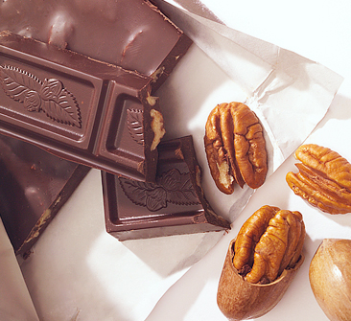
Dark chocolate
Contains powerful antioxidants, Flavanoids, that enhance blood flow, important for brain health and for good circulation.
Has a small amount of sugar and caffeine that enhance concentration.
Triggers “feel good…think good” endorphins!
½ to 1 oz of 70% or higher

Slide 51
C O F F E E….Coffee is Good for me!
A study done on elderly men showed that those who drank 3 cups of coffee per day had less memory loss than those who did not.
Another study found that decaf coffee drinker had a decline in memory performance as the day wore on but this was not the case with caffeinated coffee drinkers.

Slide 52
An Exception to the Rule… Extra Virgin Coconut Oil?
Uniquely high in shorter chains of saturated fatty acids known as medium chain triglycerides that boost HDL.
Enjoy in moderation, long term studies are pending.
Use for frying, it stands up well to very high heat and produces a wonderful crisp finished product.

Slide 53
Caution….
The American Heart Association, the U.S. Department of Agriculture and the American Dietetic Association warn against consuming coconut oil because of its high saturated fat content, which can raise cholesterol and blood lipids, possibly leading to heart disease.
However, some recent small studies have shown that coconut oil, particularly organic extra virgin coconut oil, may have some health benefits if consumed in small amounts.
Some studies use hydrogenated coconut oils that contain trans fats, which have been linked to higher cholesterol and LDL levels.
More recent studies using virgin coconut oil have shown health benefits.

Slide 54
Freshly Brewed Tea
2-3 cups a day, hot or iced, contains a modeset amout of caffeine which can boost brain power by enhancing memory, focus and mood.
Has potent antioxidants that promote healthy blood flow.
Bottled or powdered teas DON’T have the same affect.
HAS to be freshly brewed!

Slide 55
Turmeric (Curcuma longa)
Member of the ginger family
Also knows as Indian Saffron
Use for making curry and yellow mustard
Contains iron, manganese, potassium, vitamin B6 and vitamin C
Curcumin is a phytochemical found in turmeric that has strong antioxidant and anti-inflammatory properties.
In a rat study, supplementation with curcumin was found to counteract the oxidative damage and cognitive impairment encountered in the injured brain.

Slide 56
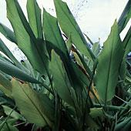
Turmeric
Turmeric is the key spice in curry that gives it its yellow color.
Curcumin, the most commonly studied compound in turmeric, is known for its ability to reduce inflammation, thereby offering preventive benefits for a host of diseases including diabetes, arthritis, and Alzheimer’s disease.
A recent study found that aromatic-turmerone, another compound in the spice, may help brain cells repair themselves.
Although turmeric is common in curry, you can get this spice on its own. It has a mild, smoky flavor, making it easy to add to any dish.
Sprinkle it on steamed vegetables, or add color and flavor to fish and chicken.
It also makes a great food dye, as only a little bit will turn anything yellow.
- See more at: http://share.upmc.com/2015/02/spices-boost-brain/#sthash.gcDGlUCn.dpuf

Slide 57
Side Effects: Turmeric usually does not cause significant side effects; however, some people can experience stomach upset, nausea, dizziness, or diarrhea.
Interactions:
Medications that slow blood clotting (Anticoagulant / Antiplatelet drugs) interacts with Turmeric. Turmeric might slow blood clotting. Taking turmeric along with medications that also slow clotting might increase the chances of bruising and bleeding.

Slide 58
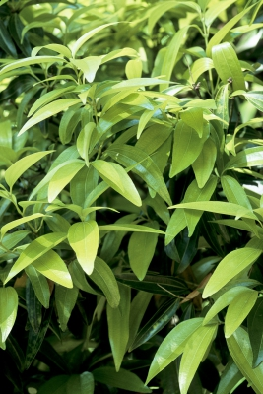
Cinnamon
Antioxidant content ranks with blueberries and pomegranates.
Reduces inflammation, fights bacteria and makes you more alert.
One study has shown that cinnamon can increase cognitive functioning, even just through smell alone, and it is being considered as a possible treatment to enhance cognition in the elderly and people with symptoms of dementia.
When adding cinnamon to your daily diet, a little goes a long way. Just half a teaspoon to one teaspoon a day is all you need.
That’s a little sprinkle in your coffee, cereal, oatmeal, or toast. For an added kick at dinner, try adding cinnamon to a spice rub with your favorite peppery spices.
- See more at: http://share.upmc.com/2015/02/spices-boost-brain/#sthash.gcDGlUCn.dpuf

Slide 59
Basil
This potent antioxidant improves blood flow to the heart and brain and has anti-inflammatory properties that offer protection from Alzheimer’s disease.
Basil is a good source of vitamin C, calcium, magnesium, potassium, and iron
Basil adds its subtle magic to just about every kind of dish from appetizer to salad to dessert.
A member of the mint family, basil adds a slightly sweet Mediterranean-inspired flavor to a range of dishes.

Slide 60
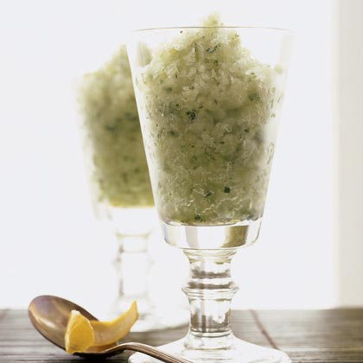
Basil-Lemon Granita
Ingredients
4 to 5 lemons (1 1/3 lb. total), rinsed
2/3 cup sugar
1/3 cup minced fresh basil leaves (Lemon Basil is good)
Preparation
1. Grate 1 tablespoon peel (yellow part only) from about three lemons. Ream juice from enough lemons to make 3/4 cup. In an 8- or 9-inch square baking pan, mix peel, juice, and 1 1/2 cups water.
2. In a food processor or blender, whirl sugar until very fine. Add basil and whirl until very finely minced. Stir sugar mixture into lemon mixture until sugar is dissolved.
3. Cover and freeze mixture until firm, about 6 hours.
4. Scrape the tines of a fork quickly across frozen mixture to break into fluffy granules. Scoop granita into chilled bowls or wine or sherbet glasses and serve immediately.
http://www.myrecipes.com/how-to/7-ways-with/recipes-using-fresh-basil
This light and refreshing Italian dessert ice is a beautiful end to any meal. Make it early in the day so the granita has at least six hours to chill.

Slide 61
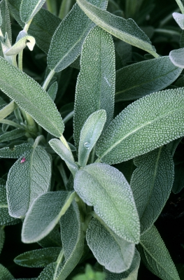
Sage
Two small studies suggest that sage may improve mood and mental performance in healthy young people and memory and attention in older adults. Results of another small clinical study suggest that a sage extract was better than placebo at enhancing thinking and learning in older adults with mild to moderate Alzheimer’s disease.
Sage is generally regarded as safe by the U.S. Food and Drug Administration and is approved for food use as a spice or seasoning.
However, some species of sage contain thujone, which can affect the nervous system. Extended use or taking large amounts of sage leaf or oil may result in restlessness, vomiting, vertigo, rapid heart rate, tremors, seizures, and kidney damage. It also may lead to wheezing.
Ingesting 12 drops or more of the essential oil is considered a toxic dose.
https://nccih.nih.gov/health/sage

Slide 62
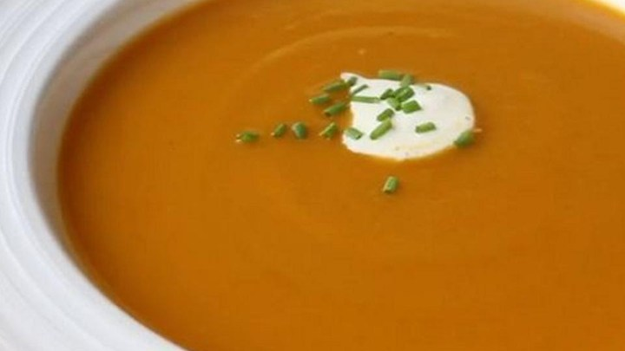
Roasted Butternut Squash Soup
Recipe by: Chef John
"My favorite fall soup of all time, roasted butternut squash soup is cheap, easy, nutrition, and absolutely delicious.
View the recipe at:
http://allrecipes.com/recipe/245272/chef-johns-roasted-butternut-squash-soup/

Slide 63
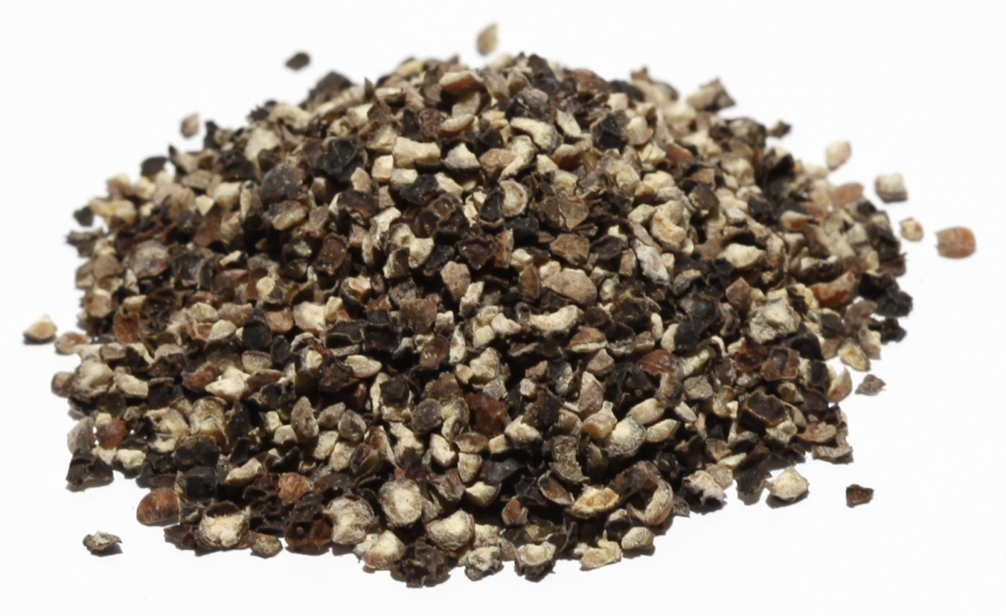
Black Pepper
Studies have shown that piperine, the primary component in black pepper, can help improve brain function and lower depression symptoms.
It’s also great to pair with other foods and spices, especially turmeric, because it may improve the bioavailability of nutrients in other foods.
- See more at: http://share.upmc.com/2015/02/spices-boost-brain/#sthash.gcDGlUCn.dpuf

Slide 64
Find a Vitamin or Supplement (WebMD) http://www.webmd.com/vitamins-supplements/ Herbs at a Glance (National Institute of Health) https://nccih.nih.gov/health/herbsataglance.htm
Searchable Data Bases

Slide 65
A toast to healthy foods, Herbs and spices
Pam VanKampen, RDN, CD
Greater WI Agency on Aging Resources
Pam.vankampen@gwaar.org

Slide 66
References & Books
http://www.webmd.com/diet/ss/slideshow-diet-for-stress-management
http://www.webmd.com/diet/ss/slideshow-sugar-addiction
Brian Wansick, PhD. Book “Mindless Eating” and new book coming Sept. 2014 is “Slim by Design”. www.mindlesseating.com
Recipes:
www.Yummly.com
Recipe modification guide http://www.nutrition411.com/education-materials/healthful-eating/item/1051-recipe-modification-guide
http://choosemyplate.gov/healthy-eating-tips/sample-menus-recipes.html

Slide 67
Resources
Eat Your Way to Happiness by Elizabeth Somer http://www.amazon.com/Eat-Your-Happiness-Elizabeth-Somer/dp/0373892071/ref=sr_1_1?ie=UTF8&qid=1305161278&sr=8-1
Dr. Ann’s Eat Right for Life by Ann G. Kulze, MD www.drannwellness.com
101 Optimal Life Foods and 101 Foods that Could Save Your Life by David Grotto, RD, LDN
Intuitive Eating A Revolutionary Program that Works by Evelyn Tribole, MS, RD and Elyse Resch, MS, RD, FADA
Press Pause Before You Eat by Dr. Linda Mintle http://www.amazon.com/Press-Pause-Before-You-Eat/dp/B0045JL8MQ/ref=sr_1_1?ie=UTF8&s=books&qid=1305161334&sr=1-1
Life is Hard, Food is Easy and 100 Days of Weight Loss by Linda Spangle, RN, MA Visit her website at www.foodiseasy.com to order one or both of her books.

